Slide 1
CS 766 Final Project
Tim Winfree

Slide 2
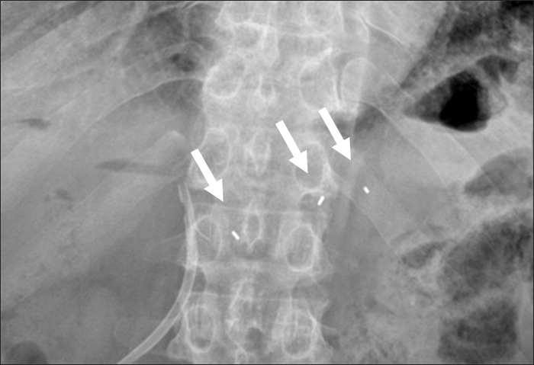
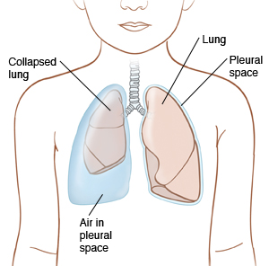
Overview
In radiotherapy, we want to track tumors that move due to respiration with the idea of gating or tracking the tumor with the beam
Track 3D from 2D position on radiographs
Detection facilitated by fiducial markers
Clinical risk associated with the implantation of these markers
Pneumothorax in 15-20% of patients according to one study
As such there is clinical demand for markerless tracking methods
3 fiducial markers in a radiograph

Slide 3
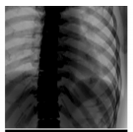
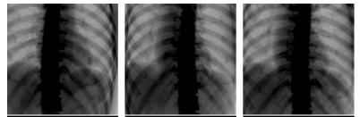

Template Matching
Live image
Pixels throughout an image have a phase dependance due to
Template matching can be used to deduce the phase of each incoming radiograph
Tumor position assumed from 4D planning CT
Template Matching
Phase of live image
Simulated X-Ray projections at each phase
Tumor 3D Position
$t_{1}$ ${ t}_{2}$ ${ t}_{3}$
Planning CT

Slide 4
Template Matching (cont)
Pros:
Tumor doesn’t have to be visible
Simple to implement
Cons:
Assumes rigid tumor motion trace
Ideally, we would like to track the tumor directly from the live radiographs

Slide 5
Direct Markerless Tumor Tracking Workflow
Intra-treatment images
Inputs
Project Tumor Mask onto the virtual detector
Tumor Mask
Training
CNN
Simulated X-Ray projections
Segmentation and centroid calculation
Planning CT
Tumor 3D Position
Triangulation from multiple frames

Slide 6
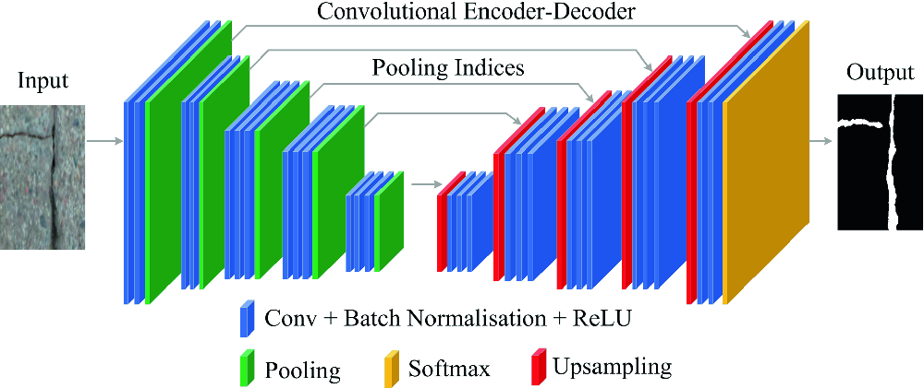

SegNet
Our tumor segmentation problem is one of binary, pixelwise classification
Encoder layers extract features at different resolutions of the image
Decoder layers upsample the image back to its native resolution so we can perform pixelwise classification

Slide 7


Triangulation
We define an accumulator array in the general region we expect to find the tumor
Each ray contributes one vote to each pixel of the accumulator that it intersects. The tumor position is chosen as the position with the most votes
By employing this voting scheme we can obtain an estimate of the tumors 3D position that is robust to outliers
Accumulator array: 4 overlapping rays overrule an outlier
Rotation of the xray source enables triangulation of the tumors position from adjacent frames

Slide 8
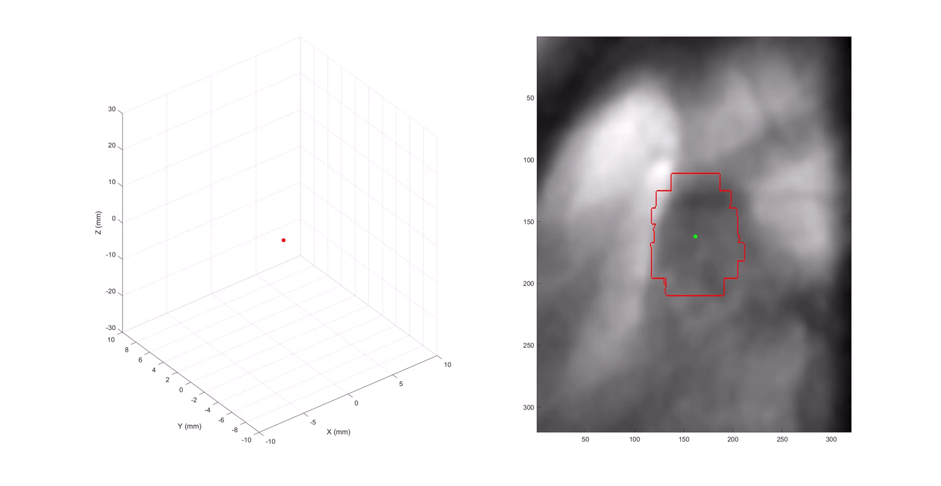
Final Result

Slide 9
References
1. Bibault, JE., Prevost, B., Dansin, E. et al. Image-Guided Robotic Stereotactic Radiation Therapy with Fiducial-Free Tumor Tracking for Lung Cancer. Radiat Oncol 7, 102 (2012). https://doi.org/10.1186/1748-717X-7-102 2.
Noriyasu Homma, Yoshihiro Takai, Haruna Endo, Kei Ichiji, Yuichiro Narita, Xiaoyong Zhang, Masao Sakai, Makoto Osanai, Makoto Abe, Norihiro Sugita, Makoto Yoshizawa, "Markerless Lung Tumor Motion Tracking by Dynamic Decomposition of X-Ray Image Intensity", Journal of Medical Engineering, vol. 2013, Article ID 340821, 8 pages, 2013. https://doi.org/10.1155/2013/340821
Terunuma, T., Tokui, A. Sakae, T. Novel real-time tumor-contouring method using deep learning to prevent mistracking in X-ray fluoroscopy. Radiol Phys Technol 11, 43–53 (2018). https://doi.org/10.1007/s12194-017- 0435-0 Cui Y, Dy JG, Alexander B, Jiang SB.
Fluoroscopic gating without implanted fiducial markers for lung cancer radiotherapy based on support vector machines. Phys Med Biol. 2008 Aug 21;53(16):N315-27. doi: 10.1088/0031-9155/53/16/N01. Epub 2008 Jul 25. PMID: 18660557.
Cui Y, Dy JG, Sharp GC, Alexander B, Jiang SB. Multiple template-based fluoroscopic tracking of lung tumor mass without implanted fiducial markers. Phys Med Biol. 2007 Oct 21;52(20):6229-42. doi: 10.1088/0031-9155/52/20/010. Epub 2007 Oct 1. PMID: 17921582.

